Slide 1
Vitamin B₁₂ and coenzymes

Slide 2
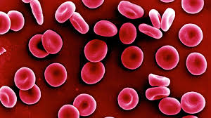
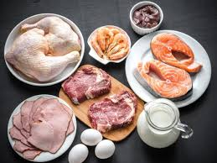
The story of vitamin B12 began when physicians recognized that anemia, a fatal disease caused by a low concentration of red blood cells, could be treated effectively by feeding the patient liver. This finding sparked a race to extract the compounds in liver and isolate the vitamin capable of treating anemia.
Note:
Vitamins are compounds that our bodies require for normal functioning and must be obtained from food.

Slide 3
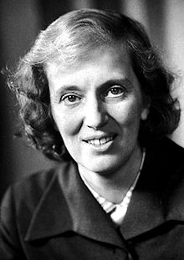
The complete structure of vitamin B12 was successfully determined by Dorothy Crowfoot Hodgkin (Oxford University) using X-ray crystallography. She was awarded the Nobel prize in chemistry in 1964 for this work.
She also solved the structures of other biologically important molecules insulin, penicillin and Cholesterol.
She found that the structure of vitamin B12 is built upon a corrin ring system, which is similar to the porphyrin ring system present in chlorophyll.

Slide 4
corrin ring
Structure is very close to porphyrin
It is also comprised of four heterocycles (rings containing a heteroatom, such as nitrogen) joined together in a macrocycle.
Missing of one of the methylidyne linkage b/w two adjacent pyrroles.
It has only one NH group.
Porphyrin
Corrin

Slide 5
VITAMin B₁₂
Water soluble, heat stable and red in colour
It consists of corrin ring system
It contain one cobalt atom connected to four nitrogen atoms
The carbons at the periphery of the corrin ring are saturated
The fifth valency of the cobalt is covalently linked to a substituted benzimidazole ring. This is then called cobalamin.
Note:
Cobinamide, in which benzimidazole nucleotide is absent

Slide 6
VITAMin B₁₂
Corrin ring bear seven amide groups as substituents.
Three of these are acetamides, and three are propionamides.
One amide is N-substituted propionamide, connected through the 2–carbon to an unusual ribonucleotide (ribonucleotide is the base unit, 5,6-dimethylbenzimidazole)

Slide 7
VITAMin B₁₂
The sixth valency of the cobalt is satisfied by the following groups (R).
Cyanide (Cyanocobalamin)
H₂O (aquacobalamin or B12a)
Hydroxyl (Hydroxy cobalamin or vitamin B12b)
Adenosyl (Adenosyl cobalamin or Ado-B12 or B12 coenzyme)
Methyl (Methyl cobalamin)
Note:
Ado-B12 and methyl B12 are the functional coenzymes in the body

Slide 8
VITAMin B₁₂
The cobalt center in B12 can exist in +1,+2 and +3 state such as,
B12a(Co^{III}) aquacobalamin
B12b(Co^{III}) hydroxycobalamin
B12r(Co^{II})
B12s(Co^{I})
There are two one-step electron reductions of B12 in biological system
+e
+e
B_{12a} (Co^{III})
B_{12r} (Co^{II})
B_{12s} (Co^{I})
Red, low spin
brown, low spin
green

Slide 9
VITAMin B₁₂
B_{12a}, aquacobalamin, R=H₂O, is reduced to B_{12r} by
Ascorbic acid, An electrochemical process, Catalytic hydrogenation,SnCl2, Thiols etc.
B_{12a} takes part in many reactions
Loss of H+ to give hydroxocobalamin
Displacement of 5, 6-dimethylbenzimidazole in strong acid by CN to give
dicyanocobalamin
B_{12r} is reduced to B_{12s} by NaBH₄ or electrochemically
B_{12r} behaves like a free radical due to the odd electron in the d_{z}² orbital
The d_{z}² elctrons in B_{12s} behaves as lone pairs.

Slide 10
VITAMin B₁₂
The B_{12s} is a powerful reducing agent and it can reduce O₂ to H₂O under biological conditions. It is also very good nucleophile and this property can be utilized to synthesize various types of cobalamins in vitro. These reactions are oxidative addition in nature.

Slide 11
VITAMin B₁₂
Biomethylation
MeCbl
FH4
Homocysteine
N5-Methyl FH4
Methionine
Cbl

Slide 12
VITAMin B₁₂
Methylmalonyl-CoA mutase activity of cobalamin
It is also known as methylmalonyl isomerase,
this vitamin B₁₂ dependent enzyme catalyzes the isomerization of methylmalonyl-CoA
to succinyl-CoA in humans.
methylmalonyl-CoA
succinyl-CoA

